Slide 1
Using R for Number Crunching
August 2, 2024

Slide 2


What is R?
R programming language is a free, tool used for statistics and analytics
Notes:
Agency Overview: Option 2

Slide 3
It can easily handle large datasets that cause Excel to freeze.
Code can be reused, recycled, and shared to get work done faster.
Reproducibility means that there’s built-in consistency with whatever you make.
Charts, maps, tables, and other visualizations can look extremely good.
It’s open-source and free.
It has a large support community (including OPI, BBMR, DGS, MORP, MONSE, Fire, BCHD)
Why use R
For number crunching?
Notes:
Agency Overview: Option 2

Slide 4
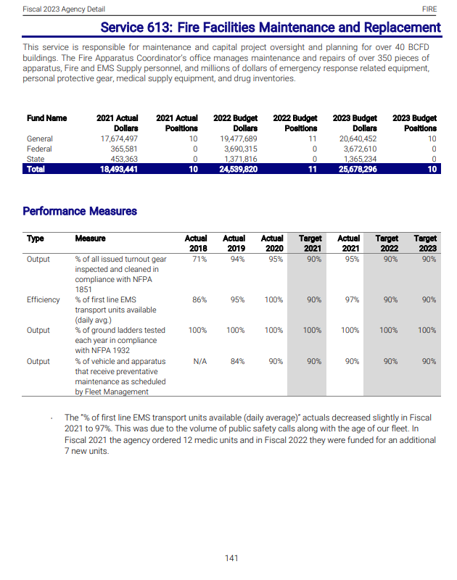
Example:
Tables and figures in the 2023 Budget Book
Notes:
Agency Overview: Option 2

Slide 5
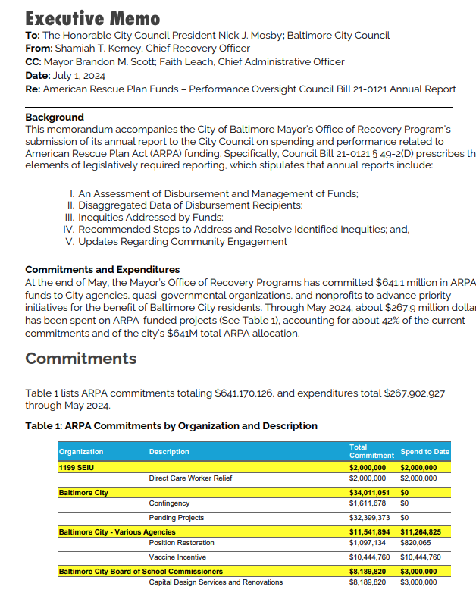
ARPA council reports
Notes:
Agency Overview: Option 2

Slide 6
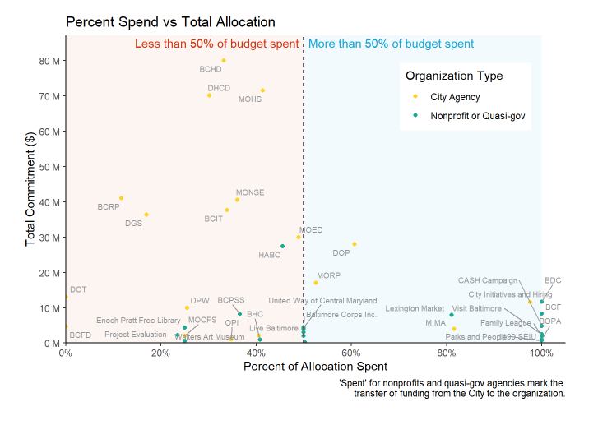
Charts displaying financial information
Notes:
Agency Overview: Option 2

Slide 7
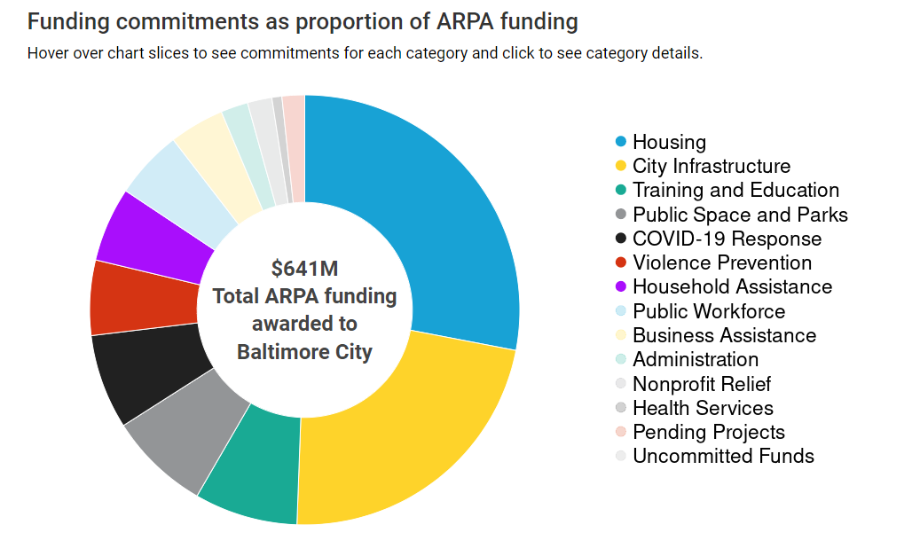
Charts displaying financial information
Notes:
Agency Overview: Option 2

Slide 8
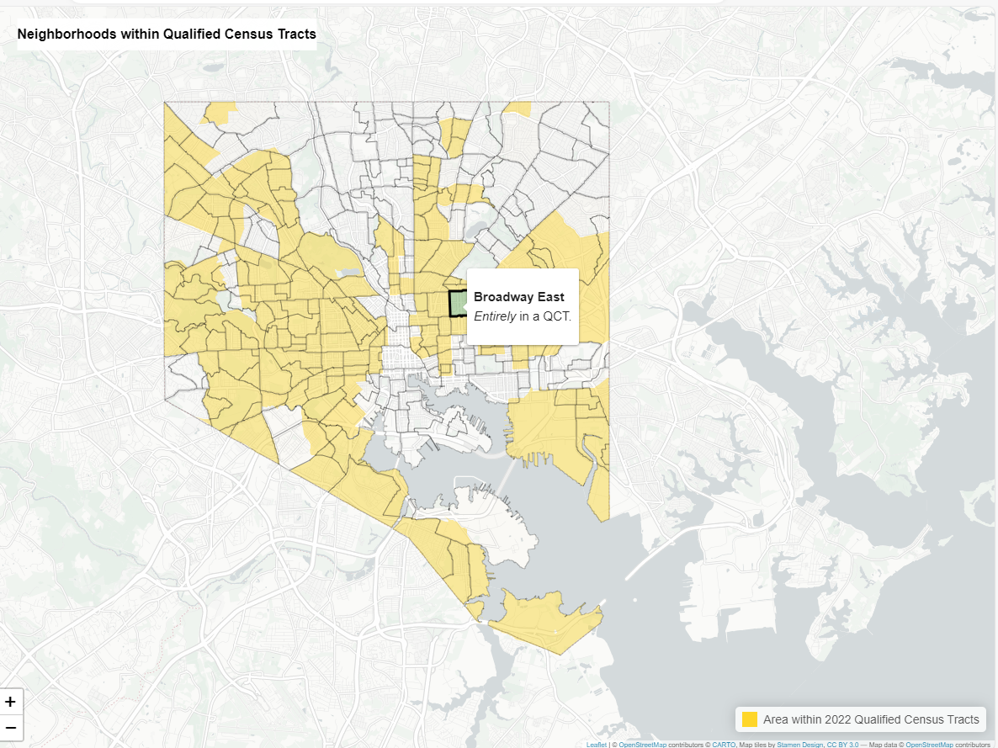
Maps
Notes:
Agency Overview: Option 2

Slide 9
What’s the downside?
Notes:
Agency Overview: Option 2

Slide 10
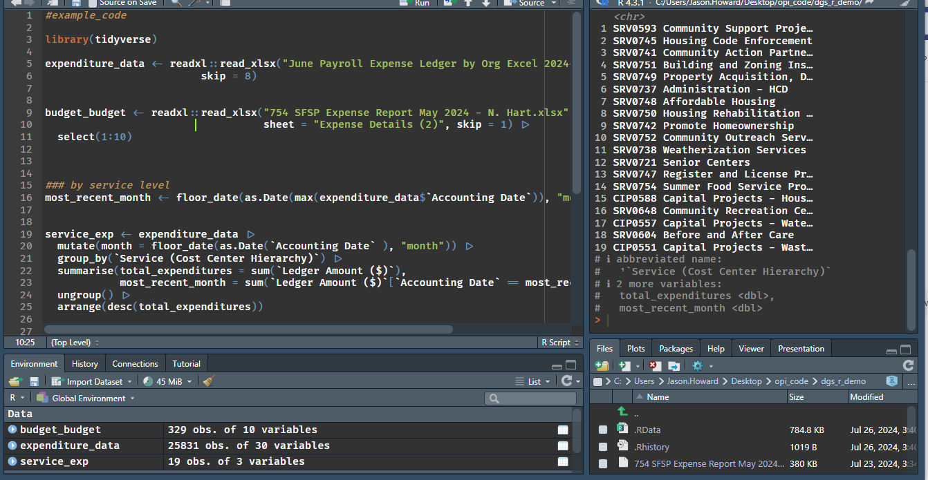
What’s the downside?
Notes:
Agency Overview: Option 2

Slide 11
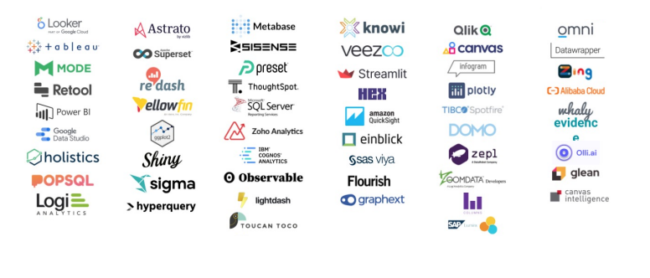
Why use R when there are so many other tools?
Notes:
Agency Overview: Option 2

Slide 12
A frequent occurrence:
Can you make me a [blank] that shows [blank]
Notes:
Agency Overview: Option 2

Slide 13
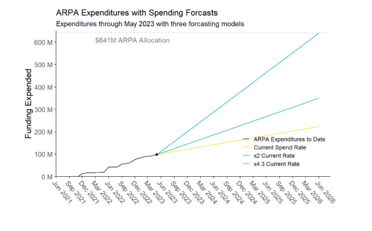
A frequent occurrence:
Can you make me a [blank] that shows [blank]
Notes:
Agency Overview: Option 2

Slide 14
A frequent occurrence:
Do you remember that [blank] that you made last month? Can you update that for this month but with [this small change]?
Notes:
Agency Overview: Option 2

Slide 15
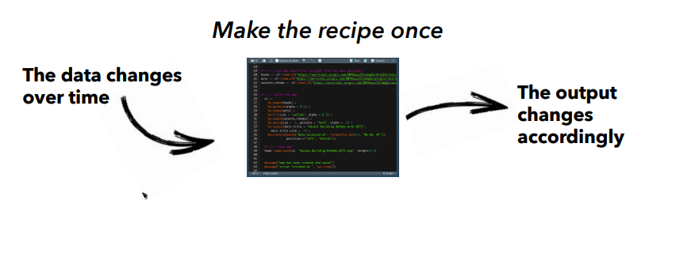
A frequent occurrence:
Do you remember that [blank] that you made last month? Can you update that for this month but with [this small change]?
Notes:
Agency Overview: Option 2

Slide 16
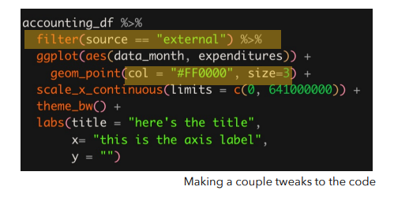
A frequent occurrence:
Do you remember that [blank] that you made last month? Can you update that for this month but with [this small change]?
Notes:
Agency Overview: Option 2

Slide 17
A frequent occurrence:
Now you’re expected to make this every month as part of your job.
Notes:
Agency Overview: Option 2

Slide 18
A frequent occurrence:
Now you’re expected to make this every month as part of your job.
Notes:
Agency Overview: Option 2

Slide 19
Notes:
Agency Overview: Option 2

Slide 20
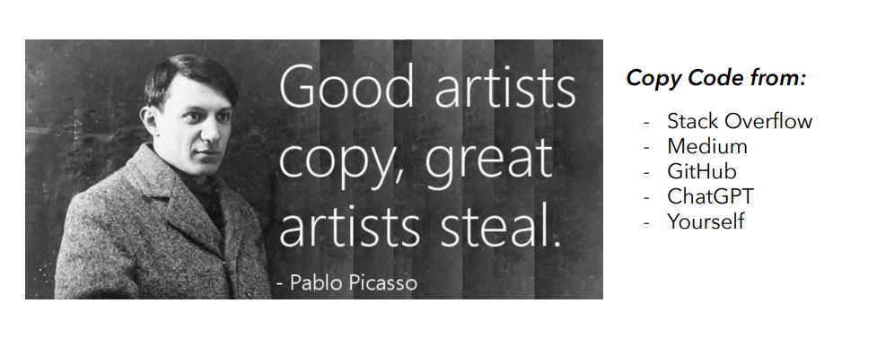
Notes:
Agency Overview: Option 2

Slide 21
Links
OPI’s R User Guide- Document on learning and using R in OPI
R basics – Popular Intro tutorial
R 4 Data Science – Comprehensive book for learning
Courses through Pratt Library – Pratt library has free Udemy courses on learning R
Notes:
Agency Overview: Option 2

